Slide 1
CMPE 220
Class 26 – Cloud Operating Systems
Notes:
Let’s talk about history.
California State Railroad Museum – 1976 - docents worked on original steam engines.

Slide 2
Types of Operating Systems
Batch / Single-Process (early computers – 1940s-50s)
Multi-Programming Systems (“modern” computers – last 1960s)
Multi-Processor Systems
Distributed Operating Systems
Network Operating Systems
Embedded Systems
Real-Time Systems
Cloud Systems
Mobile Systems

Slide 3
What is a Cloud Operating System?
Also known as a “virtual operating system,” a cloud operating system is specifically designed to function within a cloud computing and/or virtualization environment.
A cloud operating system manages the operation, execution and processes of virtual machines, virtual servers and virtual infrastructure, as well as the back-end hardware and software resources.
Similar to a distributed operating system

Slide 4
Comparison of Operating Systems
All provide a means of sharing resources across a communications network
Network Operating System: access to remote resources is explicit
Distributed Operating System: access to remote resources is implicit – programs may not know about locality of references
Cloud Operating system: manages the operation, execution and processes of virtual machines, virtual servers and virtual infrastructure, as well as the back-end hardware and software resources.

Slide 5
Essentials of Cloud Computing
National Institute of Standards and Technology (NIST):
On-Demand Self-Service – customer / client configured through a web interface
Broad Network Access – assess anywhere
Resource Polling – share physical resources
Rapid Elasticity – scale quickly on demand
Measured Service – a pay-as-you-use model

Slide 6
Additional Characteristics
Resiliency and Availability - the ability of a service to recover quickly from any disruption
Flexibility – scale without service disruption
Remote Access / Work - Remote workers can safely and quickly access corporate data and applications

Slide 7
The first Cloud OS?
The term cloud came into widespread use in 2006 when Amazon launched AWS with the Elastic Compute Cloud (EC2) service.

Slide 8
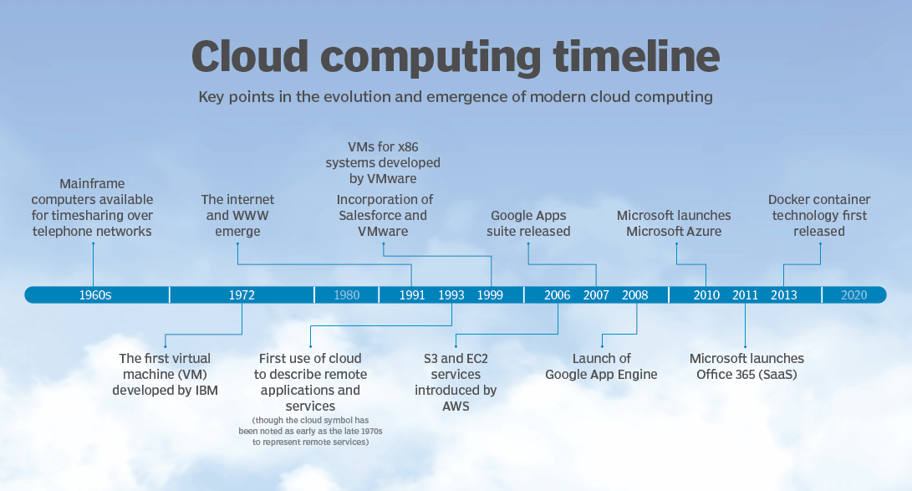
A History of Cloud Computing

Slide 9
Larry Ellison on Cloud Computing
The interesting thing about cloud computing is that we’ve redefined cloud computing to include everything that we already do. … The computer industry is the only industry that is more fashion-driven than women’s fashion. Maybe I’m an idiot, but I have no idea what anyone is talking about. What is it? It’s complete gibberish. It’s insane. When is this idiocy going to stop?

Slide 10
Larry Ellison on Cloud Computing
We’ll make cloud computing announcements because, you know, if orange is the new pink, we’ll make orange blouses. I mean, I’m not gonna fight this thing … well, maybe we’ll do an ad. Uh, I don’t understand what we would do differently in the light of cloud computing, other than market … you know, change the wording on some of our ads.

Slide 11
Larry Ellison on Cloud Computing
I started NetSuite. NetSuite was my idea. I called up Evan Goldberg and said, ‘We’re going to do ERP on the Internet, software-as-a-service.’ Six months later Marc Benioff, finding out what NetSuite was doing, and kind of copied it.

Slide 12
Larry Ellison on Cloud Computing
I like the words [cloud computing]. It’s a charismatic brand. And people do need to simplify their existing data centers and deliver services in simpler ways.

Slide 13
Larry Ellison on Cloud Computing
Virtually every important cloud service on the planet earth runs on the Oracle database. Salesforce runs on Oracle. SAP Hana powers the cloud? I’m going to try and be nice, but it’s so hard. Whose cloud are they talking about? I have no idea what runs and how, but it ain’t their cloud – it runs on Oracle. It’s rude, but it’s the truth. It’s kind of funny.

Slide 14
Cloud Architecture
Application
Virtualization Layer
Resources

Slide 15
Virtualization Layer
System Emulation
allows multiple operating systems to coexist on a single “system,” or a single OS to span multiple “systems.”
Job Distribution
File System Request Distribution
File Migration - File is copied to local machine, accessed, then copied back (requires a file locking mechanism)
I/O Request Distribution
Database Request Distribution

Slide 16
Advantages of Cloud Computing
Scalability / business agility
Resilience / fault tolerance
Hardware and data availability
Resistance to obsolescence
Centralized security
Cost?
Enables new business models

Slide 17
Business Models
Software as a Service – a third-party provider manages software applications used by the business or other entity. This includes the hardware, database and other tools that support an application
Web-based / Thin client
Scott McNealy: “The Network is the Computer”
Platform as a Service – the cloud model delivers a complete platform that’s used to develop, run and manage applications and services. It includes all compute, networking, storage, middleware and tools via the third-party cloud provider you select.
Infrastructure as a Service - incorporates third-party virtual machines within a cloud computing environment. IaaS provides the physical data center along with the fundamental network, compute and storage resources.

Slide 18
Typical Cloud Services
Application Hosting
File Sharing
Database Services
Email Services
Transparent scaling and access across a network

Slide 19
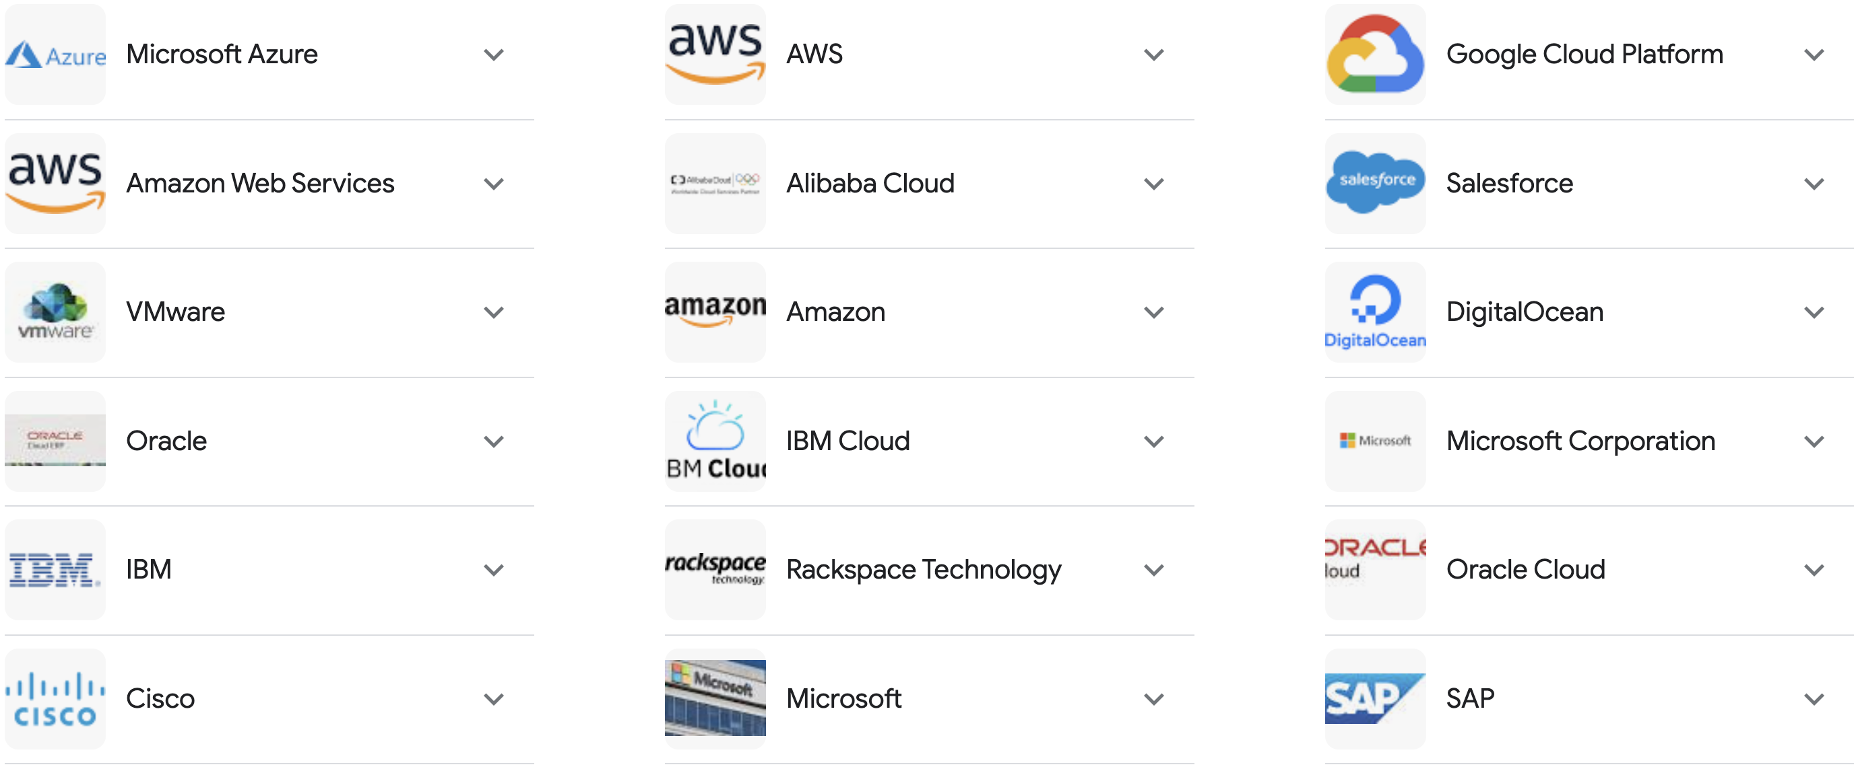
Major Cloud Computing Providers

Slide 20
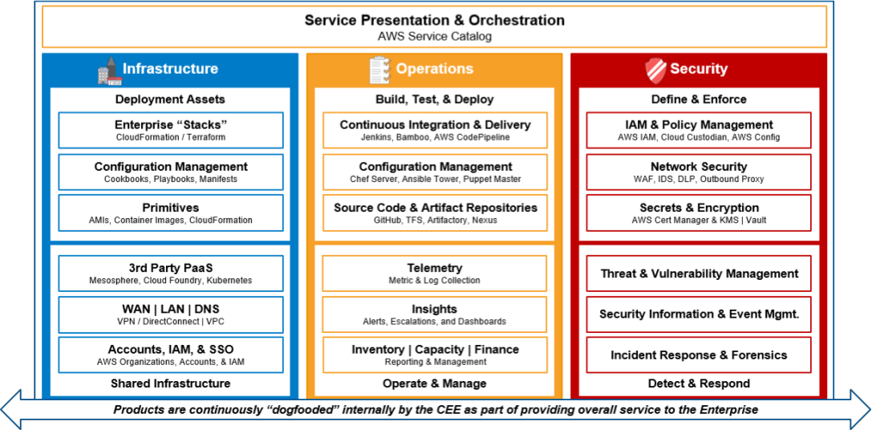
Commercial Cloud Services

Slide 21
What Operating Systems?
Major vendors use proprietary operating systems, usually based on Linux
Amazon Web Services: Amazon Linux 2 (AL2)
Google Cloud: CentOS
Oracle Cloud: Oracle Linux
Microsoft Azure: Azure HostOS (Windows) / Microsoft Hyper-V (hypervisor)

Slide 22
A Few Commercial Cloud Operating Systems
Netvibes – a web application / data analysis platform
Amoeba OS - a general-purpose distributed operating system that takes a collection of machines and works as one integrated system.
Slap OS - applies simple language for managing and provisioning operating systems. It combines grid computing and enterprise resource modelling, and any user can use it as a platform for selling software or services.
EyeOS – a platform for web applications commonly written in PHP, XML, and JavaScript.
OSv – a Linux-based “thin os” optimized for high performance.
Ghost - Global Hosted Operating System – primarilly for file sharing.
Cloudo – provides a virtual development environment
Joli OS – a web operating system optimized for end-user experience

Slide 23
Developing Applications for the Cloud
Cloud OS virtualization makes underlying architecture transparent to the user application
System Software (e.g. web servers, database servers) may be optimized for the cloud
Instrument the application for tuning
Take a DevOps approach to application deployment

Slide 24
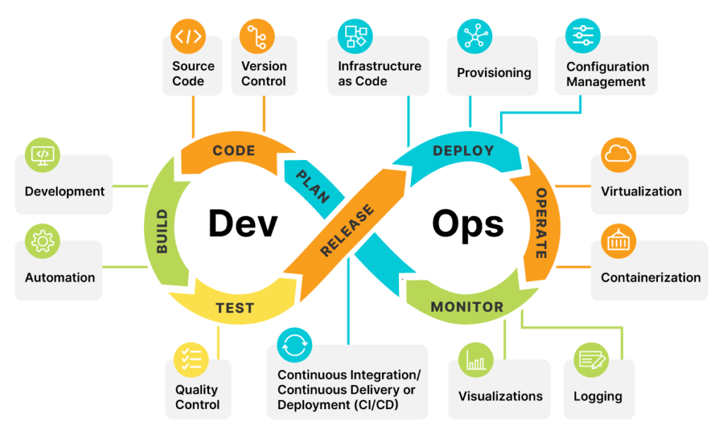
DevOps

